Slide 1
Java Capability
COLLECTION

Slide 2
Agenda
Collection Framework
List interface
ArrayList class
LinkedList class
List Iterator interface
Set interface
HashSet class
LinkedHashSet class
TreeSet class
Map interface
HashMap class
LinkedHashMap class
TreeMap class
Hashtable class
Vector
Comparable and Comparator

Slide 3
Prerequisites
Basic programming skill
Understanding of OOPS
Java knowledge mandatory

Slide 4
INTRODUCTION
A Collection is a group of objects
Collections framework provide a set of standard utility classes to manage collections
Collection Framework consists of three parts:
Core Interfaces
Concrete Implementation
Algorithms such as searching and sorting
Notes:
A Collection (sometimes called a container) is simply an object that groups multiple elements into a single unit. Collection is used to store, retrieveobjects, and to transmit them from one method to another.
The Collections API (also called the Collections framework) standardizes the way in which groups of objects are handled by your programs. It presents a set of standard utility classes to manage such collections. This framework is provided in the java.util package and comprises three mainparts:
The core interfaces, which allow collections to be manipulated independent of their implementation. These interfaces define the common functionality exhibited by collections, and facilitate data exchange between collections.
A small set of implementations, which are concrete implementations of the core interfaces, providing data structures that a program can use.
(Eg LinkedLists, Arrays, Vectors, Stack etc)
An assortment of algorithms, which can be used to perform various operations on collections, such as sorting and searching.
The collection classes are useful in a variety of ways and are the fundamental building blocks of the more complicated data structures used in other java packages in your own applications. There are several types of collections. They vary in storage mechanisms used, in the way they access data and in the rules about what data may be stored.
Note : The Java Collection technology is similar to the Standard Template Library (STL) defined by C++.

Slide 5
Advantages of collection
Reduces programming effort
Increases performance
Provides interoperability between unrelated APIs
Reduces the effort required to learn APIs
Reduces the effort required to design and implement APIs
Fosters Software reuse
Notes:
Reduces programming effort by providing useful data structures and algorithms so you don't have to write them yourself.
Increases performance by providing high-performance implementations of useful data structures and algorithms. Because the various implementations of each interface are interchangeable, programs can be easily tuned by switching implementations.
Provides interoperability between unrelated APIs by establishing a common language to pass collections back and forth.
Reduces the effort required to learn APIs by eliminating the need to learn multiple ad hoc collection APIs.
Reduces the effort required to design and implement APIs by eliminating the need to produce ad hoc collections APIs.
Fosters software reuse by providing a standard interface for collections and algorithms to manipulate them.
5

Slide 6
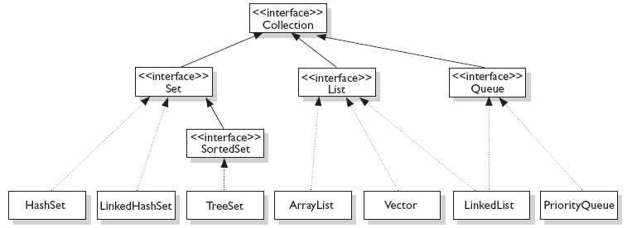
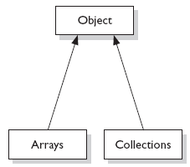
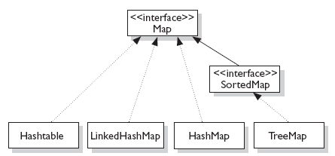
Interfaces and their implementation
Notes:
The core collection interfaces are the interfaces used to manipulate collections, and to pass them from one method to another. The basic purpose of these interfaces is to allow collections to be manipulated independently of the details of their representation.
When you understand how to use these interfaces, you know most of what there is to know about the framework. The core collections interfaces in hierarchical order are shown in Fig:1
Not all collections in the Collections Framework actually implement the Collection interface. Specifically, none of the Map-related classes and interfaces extend from Collection. So while SortedMap, Hashtable, HashMap, TreeMap, and LinkedHashMap are all thought of as collections, none are actually extended from Collection.
Note: Collections is a class, with static utility methods, while Collection is an interface with declarations of the methods common to most collections including add(), remove(), contains(), size(), and iterator().
6

Slide 7
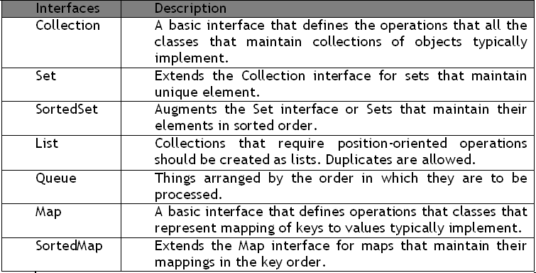
Collection Interfaces
Notes:
These are the 4 major interfaces:
Set Interface
A Set cares about uniqueness. It doesn't allow duplicates.
List Interface
A List cares about the index. The one thing that List has that non-lists don't have is a set of methods related to the index. Those key methods include things like get(int index), indexOf(Object o), add(int index, Object obj), and so on.
Queue Interface
A Queue is designed to hold a list of "to-dos," or things to be processed in some way. Although other orders are possible, queues are typically thought of as FIFO (first-in, first-out). Queues support all of the standard Collection methods and they also add methods to add and subtract elements and review queue elements.
Map Interface
A Map cares about unique identifiers. You map a unique key (the ID) to a specific value, where both the key and the value are, of course, objects. You're probably quite familiar with Maps since many languages support data structures that use a key/value or name/value pair. The Map implementations let you do things like search for a value based on the key, ask for a collection of just the values, or ask for a collection of just the keys. Like Sets, Maps rely on the equals() method to determine whether two keys are the same or different.
7

Slide 8
TYPES OF COLLECTION CLASS
The Collection classes
LinkedList
ArrayList
HashSet
LinkedHashSet
TreeSet
The Legacy classes
Dictionary
HashTable
Properties
Stack
Vector
There is only one legacy interface called Enumeration
NOTE: All the legacy classes are synchronized

Slide 9
Common Methods of Collection
Modifier and Type | Method and Description
boolean | add(E e) Ensures that this collection contains the specified element (optional operation).
boolean | addAll(Collection<? extends E> c) Adds all of the elements in the specified collection to this collection (optional operation).
boolean | contains(Object o) Returns true if this collection contains the specified element.
boolean | containsAll(Collection<?> c) Returns true if this collection contains all of the elements in the specified collection.
Iterator<E> | iterator() Returns an iterator over the elements in this collection.
boolean | remove(Object o) Removes a single instance of the specified element from this collection, if it is present (optional operation).
boolean | removeAll(Collection<?> c) Removes all of this collection's elements that are also contained in the specified collection (optional operation).
boolean | retainAll(Collection<?> c) Retains only the elements in this collection that are contained in the specified collection (optional operation).
int | size() Returns the number of elements in this collection.

Slide 10
Common Methods in List
Modifier and Type | Method and Description
boolean | add(E e) Appends the specified element to the end of this list (optional operation).
boolean | contains(Object o) Returns true if this list contains the specified element.
boolean | containsAll(Collection<?> c) Returns true if this list contains all of the elements of the specified collection.
E | get(int index) Returns the element at the specified position in this list.
Iterator<E> | iterator() Returns an iterator over the elements in this list in proper sequence.
boolean | remove(Object o) Removes the first occurrence of the specified element from this list, if it is present (optional operation).
boolean | removeAll(Collection<?> c) Removes from this list all of its elements that are contained in the specified collection (optional operation).
boolean | retainAll(Collection<?> c) Retains only the elements in this list that are contained in the specified collection (optional operation).
List<E> | subList(int fromIndex, int toIndex) Returns a view of the portion of this list between the specified fromIndex, inclusive, and toIndex, exclusive.

Slide 11
Commonly used Classes of List
ArrayList
LinkedList
LinkedList:
Java LinkedList class can contain duplicate elements.
Java LinkedList class maintains insertion order.
Java LinkedList class is non synchronized.
In Java LinkedList class, manipulation is fast because no shifting needs to be occurred.
Java LinkedList class can be used as list, stack or queue.

Slide 12
ArrayList
ArrayList
ArrayList class can contain duplicate elements.
ArrayList maintains insertion order.
ArrayList is non synchronized.
Allows random access because array works at the index basis.
Manipulation is slow because a lot of shifting needs to be occurred if any element is removed from the array list.

Slide 13
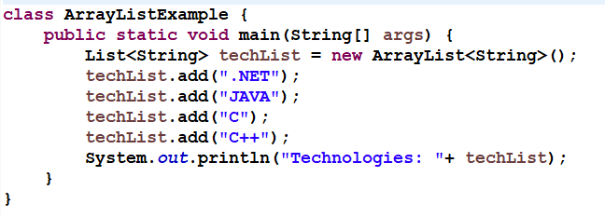
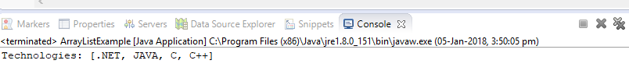
ArrayList
Output:

Slide 14
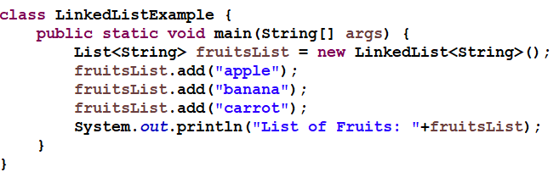
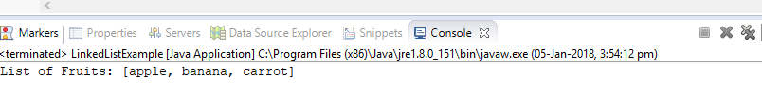
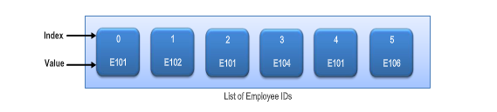
LinkedList
Output:

Slide 15
ArrayList and LinkedList Difference
ArrayList | LinkedList
1) ArrayList internally uses dynamic array to store the elements. | LinkedList internally uses doubly linked list to store the elements.
2) Manipulation with ArrayList is slow because it internally uses array. If any element is removed from the array, all the bits are shifted in memory. | Manipulation with LinkedList is faster than ArrayList because it uses doubly linked list so no bit shifting is required in memory.
3) ArrayList class can act as a list only because it implements List only. | LinkedList class can act as a list and queue both because it implements List and Deque interfaces.
4) ArrayList is better for storing and accessing data. | LinkedList is better for manipulating data.

Slide 16
Set
A Set is a Collection that cannot contain duplicate elements.
boolean | add(E e) Adds the specified element to this set if it is not already present (optional operation).
boolean | addAll(Collection<? extends E> c) Adds all of the elements in the specified collection to this set if they're not already present (optional operation).
boolean | contains(Object o) Returns true if this set contains the specified element.
boolean | containsAll(Collection<?> c) Returns true if this set contains all of the elements of the specified collection.
boolean | remove(Object o) Removes the specified element from this set if it is present (optional operation).
boolean | retainAll(Collection<?> c) Retains only the elements in this set that are contained in the specified collection (optional operation).
int | size() Returns the number of elements in this set (its cardinality).

Slide 17
Commonly used classes of Set
HashSet
LinkedHashSet
TreeSet

Slide 18
HashSet
HashSet doesn’t maintain any order, the elements would be returned in any random order.
Doesn’t allow duplicates. If you try to add a duplicate element in HashSet, the old value would be overwritten.
Allows null values however if you insert more than one nulls it would still return only one null value.
HashSet is non-synchronized.

Slide 19
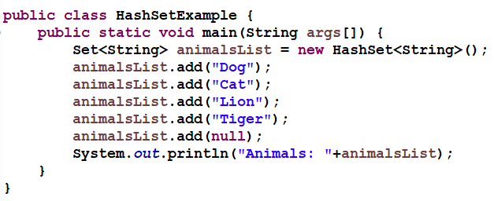
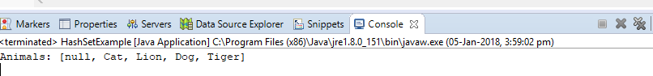
HashSet Example
Output:

Slide 20
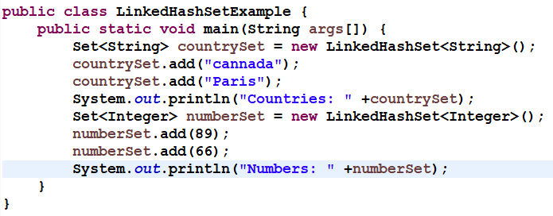
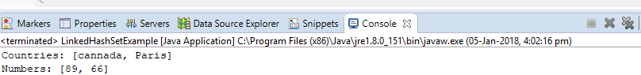
LinkedHashSet
LinkedHashSet maintains the insertion order. Elements gets sorted in the same sequence in which they have been added to the Set.
Output:

Slide 21
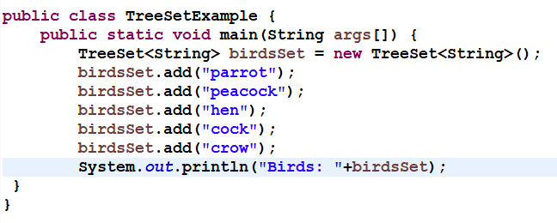

TreeSet
The objects of TreeSet class are stored in ascending order.
Output:

Slide 22
Map
The Map interface maps unique keys to values
Modifier and Type | Method and Description
boolean | containsKey(Object key) Returns true if this map contains a mapping for the specified key.
boolean | containsValue(Object value) Returns true if this map maps one or more keys to the specified value.
Set<Map.Entry<K,V>> | entrySet() Returns a Set view of the mappings contained in this map.
V | get(Object key) Returns the value to which the specified key is mapped, or null if this map contains no mapping for the key.
Set<K> | keySet() Returns a Set view of the keys contained in this map.
V | put(K key, V value) Associates the specified value with the specified key in this map (optional operation).
Collection<V> | values() Returns a Collection view of the values contained in this map.

Slide 23
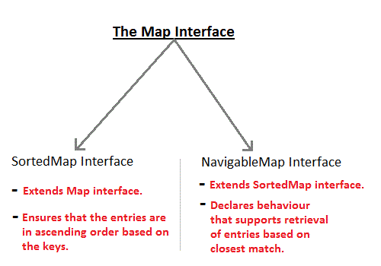
Map

Slide 24
Commonly used classes from Map
HashMap
LinkedHashMap
TreeMap

Slide 25
HashMap
It is not an ordered collection which means it does not return the keys and values in the same order in which they have been inserted into the HashMap. It does not sort the stored keys and Values
The important points about Java HashMap class are:
A HashMap contains values based on the key.
Keys are unique.
It may have one null key and multiple null values.
HashMap doesn’t maintain any order.

Slide 26
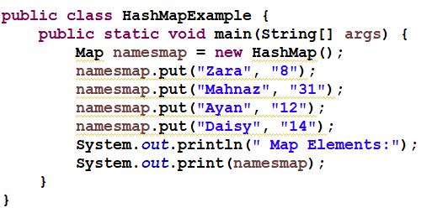
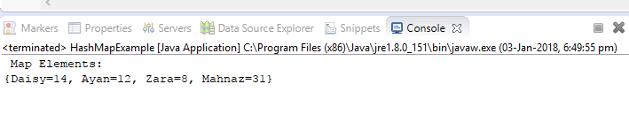
HashMap Example
Output:

Slide 27
LinkedHashMap
LinkedHashMap maintains the insertion order.
The important points about Java LinkedHashMap class are:
A LinkedHashMap contains values based on the key.
It contains only unique keys.
It may have one null key and multiple null values.
It is same as HashMap instead maintains insertion order.

Slide 28
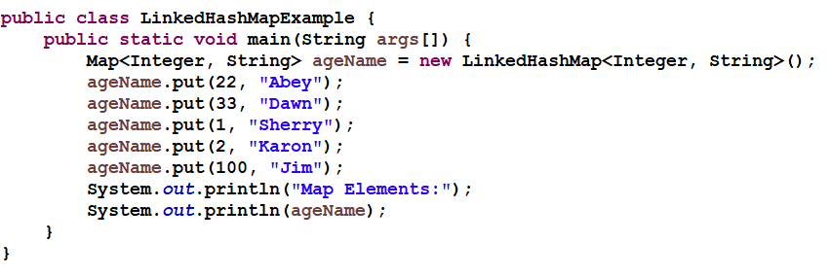
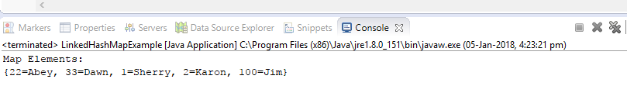
LinkedHashMap Example
Output:

Slide 29
TreeMap
It creates Map, stored in a tree structure.
A TreeMap provides an efficient means of storing key/value pair in efficient order.
It provides key/value pairs in sorted order and allows rapid retrieval

Slide 30
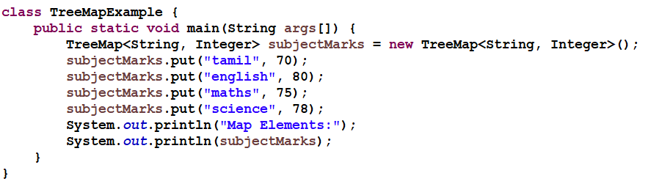
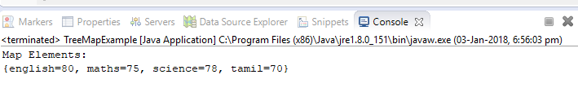
TreeMap Example
Output:

Slide 31
Iterator
Iterator(interface) is used for iterating (looping) various collection classes such as HashMap, ArrayList, LinkedList etc.
This has three methods : hasNext(), next(), remove().

Slide 32
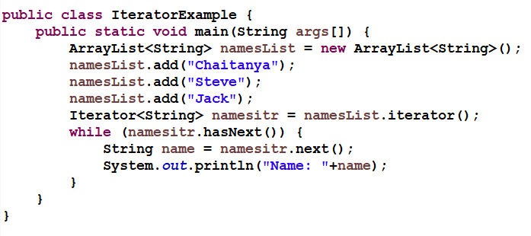
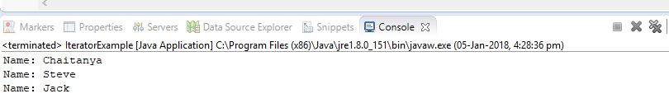
Iterator Example
Output:

Slide 33
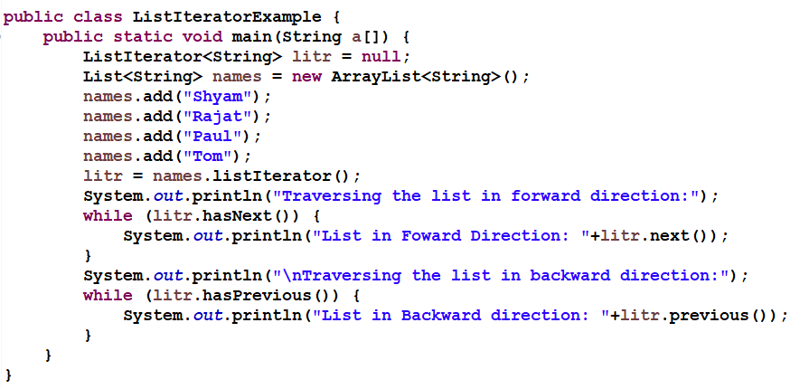
ListItreator
ListIterator that allows us to traverse the list in both directions (forward and backward).

Slide 34
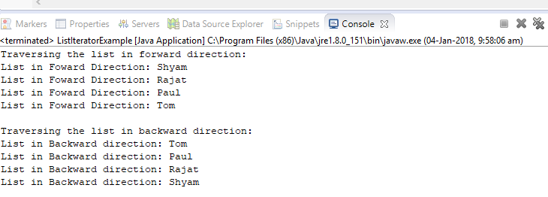
LIST ITERATOR OUTPUT

Slide 35
Arrays Class
The "java.util.Arrays" is the base class for arrays in Java which have many static methods for searching, sorting, comparing and filling arrays. All primitive type can be overloaded using these methods. The main methods are given below :
Method | Description
public static int binarySearch(Object[] a, Object key) | Searches the specified array for the specified object using the binary search algorithm.
public static boolean equals(long[] a, long[] a2) | Returns true if the two specified arrays of longs are equal to one another.
public static void fill(int[] a, int val) | Assigns the specified int value to each element of the specified array of ints.
public static void sort(Object[] a) | Sorts the specified array of objects into ascending order, according to the natural ordering of its elements.

Slide 36
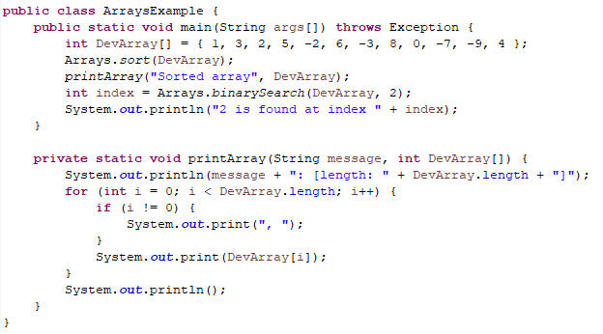
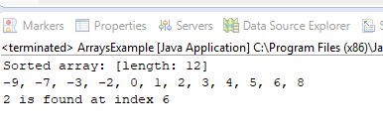
Arrays class example

Slide 37
Java Scanner class
There are various ways to read input from the keyboard, the java.util.Scanner class is one of them.
The Java Scanner class breaks the input into tokens using a delimiter that is whitespace bydefault. It provides many methods to read and parse various primitive values.
Java Scanner class is widely used to parse text for string and primitive types using regular expression.
Java Scanner class extends Object class and implements Iterator and Closeable interfaces.

Slide 38
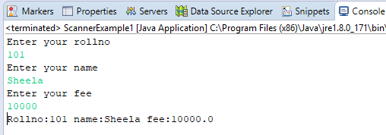
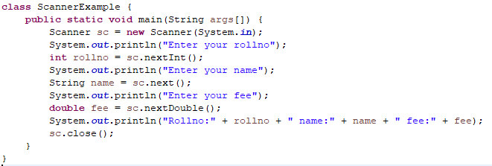
EXAMPLE

Slide 39
Vector
Vector is similar to ArrayList which represents a dynamic array.
There are two differences between Vector and ArrayList. First, Vector is synchronized while ArrayList is not
It contains many legacy methods that are not part of the Collections Framework.
Vector implements Iterable.
This means that Vector is fully compatible with collections, and a Vector can have its contents iterated by the for-each loop.

Slide 40
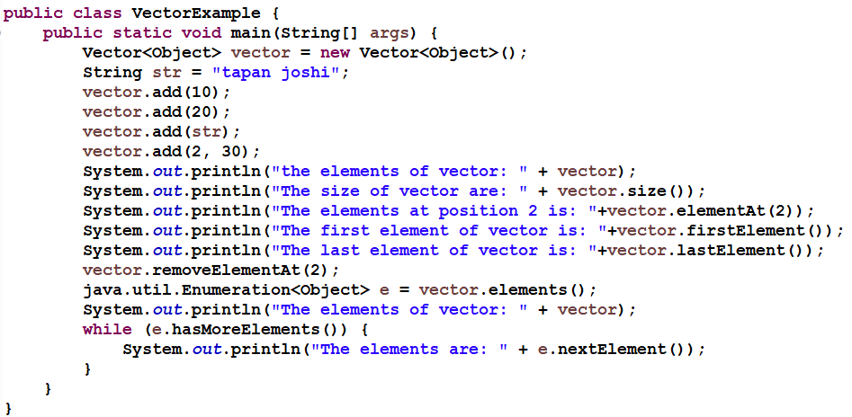
Vector Example

Slide 41
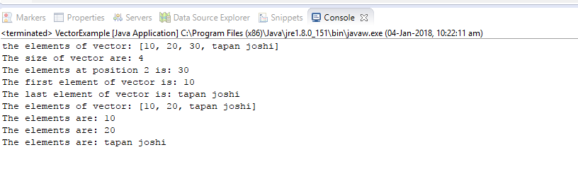
VECTOR OUTPUT

Slide 42
Queue Interface In Java
The java.util.Queue is a subtype of java.util.Collection interface. It is an ordered list of objects with its use limited to inserting elements at the end of list and deleting elements from the start of list i.e. it follows FIFO principle.
Since it is an interface, we need a concrete class during its declaration. There are many ways to initialize a Queue object, most common being-
As a Priority Queue
As a LinkedList

Slide 43
Operations on Queue :
Add()-Adds an element at the tail of queue. More specifically, at the last of linkedlist if it is used, or according to the priority in case of priority queue implementation.
peek()-To view the head of queue without removing it. Returns null if queue is empty.
element()-Similar to peek(). Throws NoSuchElementException if queue is empty.
remove()-Removes and returns the head of the queue. Throws NoSuchElementException when queue is empty.
poll()-Removes and returns the head of the queue. Returns null if queue is empty

Slide 44
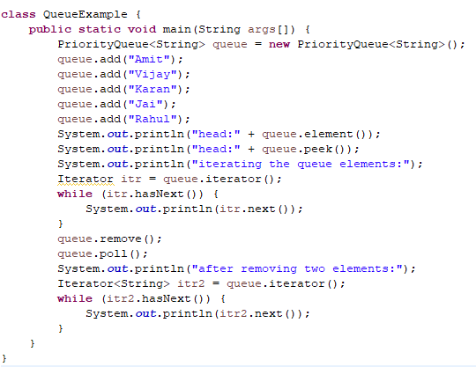
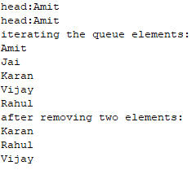
Example

Slide 45
Hashtable
A HashTable is an array of list. Each list is known as a bucket. The position of bucket is identified by calling the hashcode() method. A Hashtable contains values based on the key.
It contains only unique keys.
It may have not have any null key or value.
It is synchronized.

Slide 46
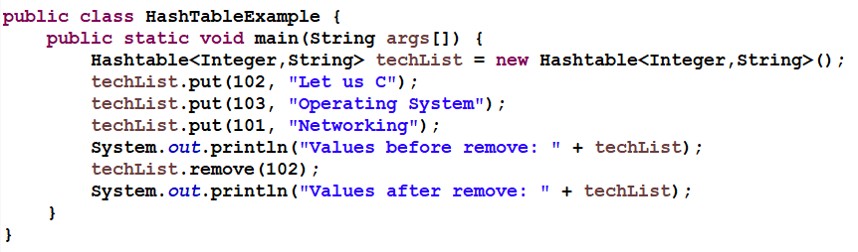
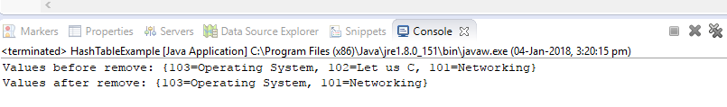
HashTable Example
Output:

Slide 47
Properties class in Java
The properties object contains key and value pair both as a string. The java.util.Properties class is the subclass of Hashtable.
It can be used to get property value based on the property key.
The Properties class provides methods to get data from properties file and store data into properties file. Moreover, it can be used to get properties of system.

Slide 48
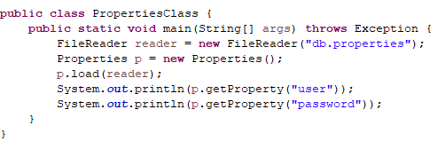
Properties class in Java
db.properties
user=system
password=oracle
Output:system
oracle

Slide 49
Enumeration
Enumeration is an interface in java which allows you to iterate or obtain one element at a time of collection.
Enumeration can generate one element at a time, it is used for collection of unknown size. Traversing element of collection is done only once per creation.
Enumeration has two methods they are as follows :
boolean hasMoreElement() : Returns true if collection has more element otherwise returns false when all element are traversed.
Object nextElement() : Return the next element in the collection.

Slide 50
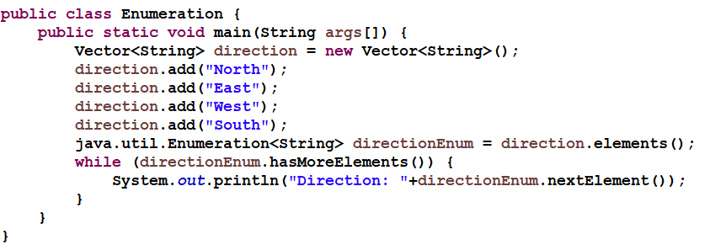
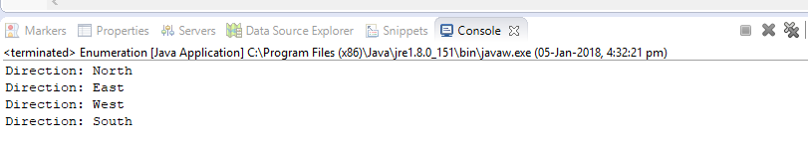
Example
Output:

Slide 51
Iterator and Enumeration Difference
Enumeration | Iterator
Using Enumeration, you can only traverse the collection. You can’t do any modifications to collection while traversing it. | Using Iterator, you can remove an element of the collection while traversing it.
Enumeration is used to traverse the legacy classes like Vector, Stack and HashTable. | Iterator is used to iterate most of the classes in the collection framework like ArrayList, HashSet, HashMap, LinkedList etc.
Methods : hasMoreElements() and nextElement() | Methods : hasNext(), next() and remove()

Slide 52
Generics
Generics allow you to define a class with placeholders for the type of its fields, methods, parameters
A generic class can be defined using angle brackets <>.
There are mainly 3 advantages of generics. They are as follows:
Type-safety : We can hold only a single type of objects in generics. It doesn’t allow to store other objects.
2) Type casting is not required: There is no need to typecast the object.
3) Compile-Time Checking: It is checked at compile time so problem will not occur at
runtime. The good programming strategy says it is far better to handle the problem at
compile time than runtime.
Syntax to use generic collection
ClassOrInterface<Type>
Notes:
Look at the following pieces of code:
List myIntegerList = new LinkedList(); // 1
myIntegerList.add(new Integer(0)); // 2
Integer x = (Integer) myIntegerList.iterator().next(); // 3
The cast on line 3 is slightly annoying. Typically, the programmer knows what kind of data has been placed into a particular list. However, the cast is essential. The compiler can only guarantee that an Object will be returned by the iterator. To ensure the assignment to a variable of type Integer is type safe, the cast is required. Of course, the cast not only introduces clutter. What if programmers could actually express their intent, and mark a list as being restricted to contain a particular data type? This is the core idea behind generics. Here is a version of the program fragment given above using generics:
List<Integer> myIntegerList = new LinkedList<Integer>(); // 1
myIntegerList.add(new Integer(0)); //2
Integer x = myIntegerList.iterator().next(); // 3
Notice the type declaration for the variable myIntegerList. It specifies that this is not just an arbitrary List, but a List of Integer, written List<Integer>. We say that List is a generic interface that takes a type parameter - in this case, Integer. We also specify a type parameter when creating the list object. The other thing to pay attention to is that the cast is gone on line 3. The compiler can now check the type correctness of the program at compile-time.

Slide 53
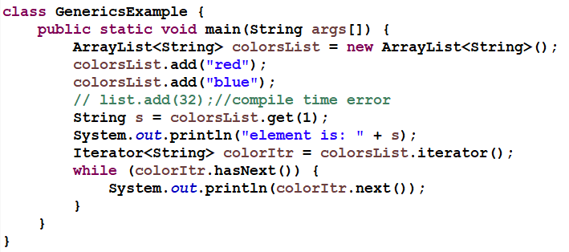
Example

Slide 54
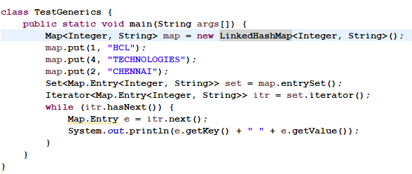
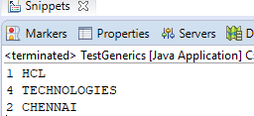
Example
Output:

Slide 55
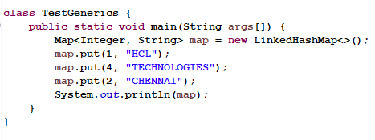
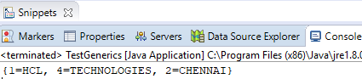
Example
Output:

Slide 56
Comparable Interface
Comparable interface is defined in java.lang package. It has only one method named compareTo(Object obj).It is used to implement natural ordering of collection elements. String and wrapper classes implements Comparable interface.
Method of Comparable interface:
compareTo(Object obj): It is used to compare this object with the specified object. It returns +ve integer if this object is greater than the specified object, 0 if this object is equals to the specified object and –ve integer if this object is less than the specified object.
Syntax: public int compareTo(Object obj).

Slide 57
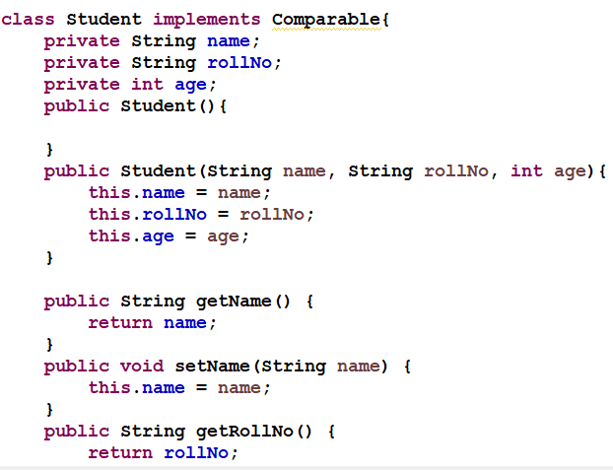
Comparable Example

Slide 58
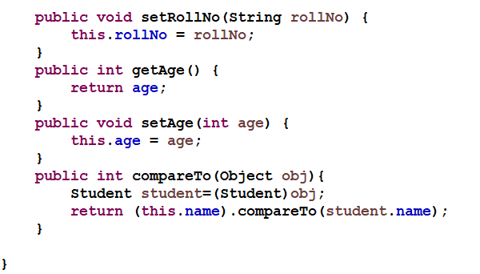
Comparable Example Contd…

Slide 59
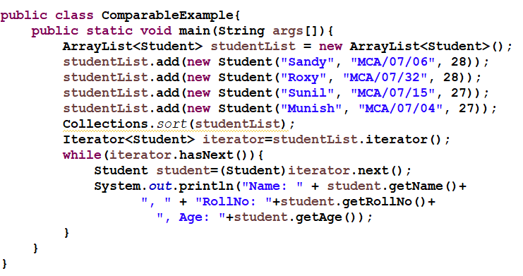
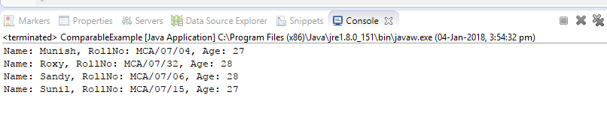
Comparable Example AND OUTPUT
Output:

Slide 60
Comparator interface
Comparator interface is defined in java.util package. It has two methods named compare(Object obj1,Object obj2) and equals(Object element).
Note: We can sort the elements based on multiple properties. Suppose we have Student class elements with name, class and rollNo as properties then by using comparable interface we can sort student objects based on one or more than one properties.
Methods of Comparator interface:
compare(Object obj1,Object obj2): It is used to compare the two objects. It returns +ve integer if first object is greater than the second object, 0 if first object is equals to the second object and –ve integer if first object is less than the second object.
Syntax: public int compare(Object obj1,Object obj2).

Slide 61
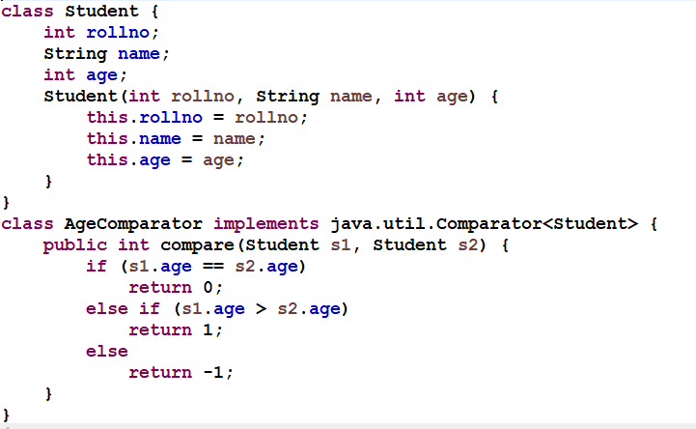
Comparator EXAMPLE

Slide 62
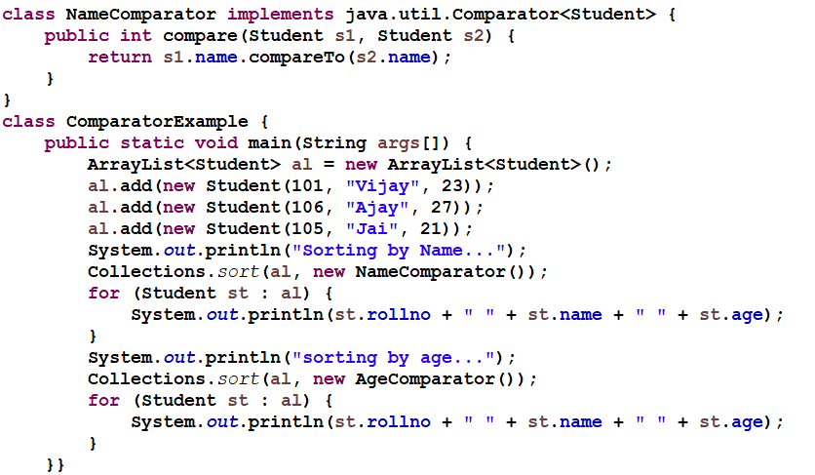
Comparator EXAMPLE

Slide 63
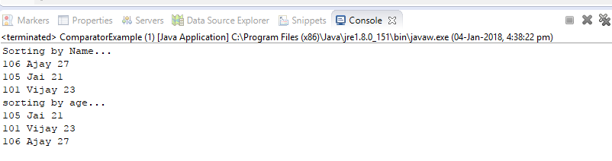
Comparator OUTPUT

Slide 64
Comparable and comparator Difference
Comparable | Comparator
1) Comparable provides single sorting sequence. In other words, we can sort the collection on the basis of single element such as id or name or price etc. | Comparator provides multiple sorting sequence. In other words, we can sort the collection on the basis of multiple elements such as id, name and price etc.
2) Comparable affects the original class i.e. actual class is modified. | Comparator doesn't affect the original class i.e. actual class is not modified.
3) Comparable provides compareTo() method to sort elements. | Comparator provides compare() method to sort elements.
4) Comparable is found in java.lang package. | Comparator is found in java.util package.
5) We can sort the list elements of Comparable type by Collections.sort(List) method. | We can sort the list elements of Comparator type by Collections.sort(List,Comparator) method.

Slide 65


Calendar
Output:

Slide 66


Calendar

Slide 67


Date EXAMPLE
Output:

Slide 68
Map.Entry
The Map.Entry interface enables you to work with a map entry.
The entrySet( ) method declared by the Map interface returns a Set containing the map entries. Each of these set elements is a Map.Entry object.

Slide 69

Map.Entry Example

Slide 70

MAP.ENTRY OUTPUT

Slide 71
ResourceBundle class in Java
The ResourceBundle class is used to internationalize the messages. In other words, we can say that it provides a mechanism to globalize the messages.
The hardcoded message is not considered good in terms of programming, because it differs from one country to another. So we use the ResourceBundle class to globalize the messages.
The ResourceBundle class loads this information from the properties file that contains the messages.
Conventionally, the name of the properties file should be filename_languagecode_country code for example MyMessage_en_US.properties.

Slide 72
Commonly used methods of ResourceBundle class
There are many methods in the ResourceBundle class.
Let's see the commonly used methods of the ResourceBundle class.
public static ResourceBundle getBundle(String basename) returns the instance of the ResourceBundle class for the default locale.
public static ResourceBundle getBundle(String basename, Locale locale) returns the instance of the ResourceBundle class for the specified locale.
public String getString(String key) returns the value for the corresponding key from this resource bundle.

Slide 73


Example of ResourceBundle class

Slide 74
STRINGTOKENIZER
The java.util.StringTokenizer class allows you to break a string into tokens. It is simple way to break string.
It doesn't provide the facility to differentiate numbers, quoted strings, identifiers etc.
Public method | Description
boolean hasMoreTokens() | checks if there is more tokens available.
String nextToken() | returns the next token from the StringTokenizer object.
String nextToken(String delim) | returns the next token based on the delimeter.
boolean hasMoreElements() | same as hasMoreTokens() method.
Object nextElement() | same as nextToken() but its return type is Object.
int countTokens() | returns the total number of tokens.

Slide 75


STRINGTOKENIZER EXAMPLE

Slide 76
Quiz
Which collection class allows you to grow or shrink its size and provides indexed access to its elements, but whose methods are not synchronized?
A. java.util.HashSet
B. java.util.LinkedHashSet
C. java.util.List
D. java.util.ArrayList
You need to store elements in a collection that guarantees that no duplicates are stored and all elements can be accessed in natural order. Which interface provides that capability?
A. java.util.Map
B. java.util.Set
C. java.util.List
D. java.util.Collection

Slide 77
Quiz
Which interface provides the capability to store objects using a key-value pair?
A. Java.util.Map
B. Java.util.Set
C. Java.util.List
D. Java.util.Collection
Which collection class allows you to access its elements by associating a key with an element's value, and provides synchronization?
A. java.util.SortedMap
B. java.util.TreeMap
C. java.util.TreeSet
D. java.util.Hashtable

Slide 78

Quiz
Output:
Sunday
Monday
Tuesday
Wednesday
Thursday
Friday
Saturday

Slide 79
References & Further Studies
https://docs.oracle.com/javase/tutorial/collections/intro/
https://www.javatpoint.com/collections-in-java
https://www.tutorialspoint.com/java/java_collections.htm

